Slide 1
Models for analysis 2
Summary of models
Bottleneck model AFS model My suggestion
Contemporary Ne n1 1-1.5 million 1-1.5 million
Historic Ne n3 1-1.5 million 1-1.5 million
Bottleneck Ne n2 1-1000 1-1000
Bottleneck Time t1 1-30 1-100
Pre-bottleneck Time t2 15-100 50-1000
Constant Pop Model
Contemp, hist & bott Ne n4 1-1.5 million 1-1.5 million
Contemporary time - 0 0
Bottleneck Time t1 - 1-100
Historic time t2 15-100 50-1000
I went with 50,000 as the top of Ne because I don’t think that Ne would actually be this high in any pop, and because of what we learned from the whales in how prior assumptions will skew posteriors- obviously a discussion point
mu microsatellite = 1-10 X 10-4 and sex ratio = 1

Slide 2
Ok Joe,
I wanted to send you what I have gotten together. This might be a good stopping point to reassess.
A few things stand out. First, under this set of priors, the Antarctic fur seal does not show the same patterns as reported in the paper. I have cross-checked my data and input files, and ran some addition simulations to ensure we didn’t have an error in the publication. We don’t.
In the ppt that is attached you’ll see posteriors for all that is calculated so far. I am paying particular attention to parameters t1 (bottleneck time) and N2 (bottleneck Ne). Some of the species show established distributions, others are still climbing. I jotted down the listing for each species. In most instances those species that are listed at some level show good distributions for t1 and n2, and a few that are classified as “Least Concern’ according to IUCN also show good distributions.
For every data set the ‘bottleneck model is highly supported. The confusing part is that a lot of them have climbing posteriors for the bottleneck parameters. I don’t know that the problem is that priors are not liberal enough, because I don’t think that populations will acquire a genetic signal for population reductions that still leave lots of Ne variation in the population. It might seem that in these datasets for which the bottleneck model is supported, but posteriors are climbing, could be a reflection of preferring all of the Nes to be the same, yet that would make one think the constant model would be supported. The last slide of the ppt shows the plot of simulations amongst the observed. One is for a population that showed great bottleneck posterior parameter distributions, one for good bottleneck posterior parameter distributions, and the other is for one that didn’t. The trend across datasets is for those with good distributions to have the posterior lying far away from the cluster of constant pop model simulations. This area of overlap between simulations of both models is the zone where the models overlap I suspect. Perhaps we can use this information to better understand the patterns we are seeing.
Caleb

Slide 3
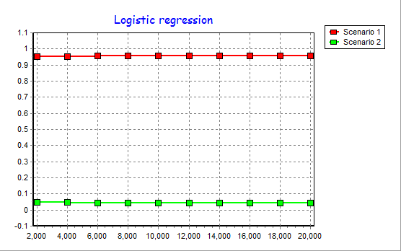
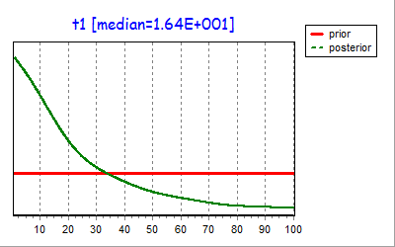
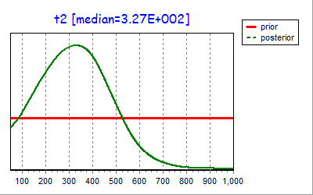
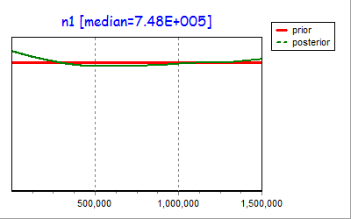
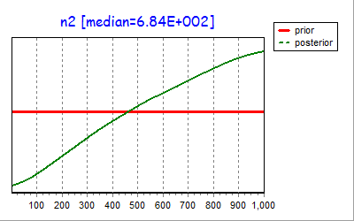
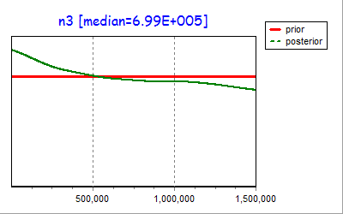
DS1 _Antarctic Fur Seal
Least Concern

Slide 4
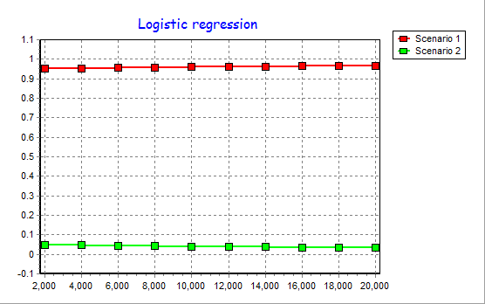
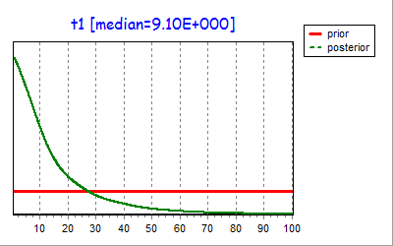
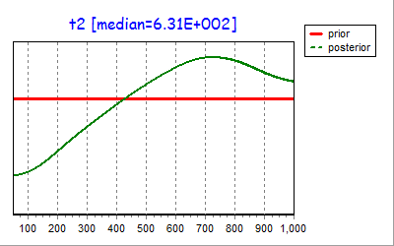
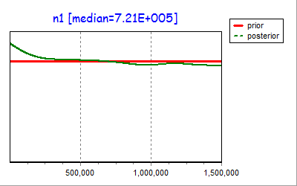
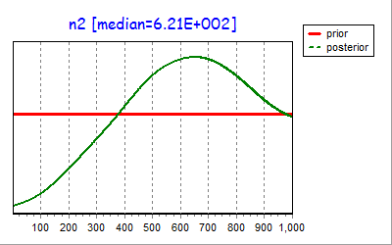
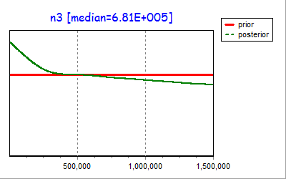
DS3_Steller Sea Lion
Endangered

Slide 5

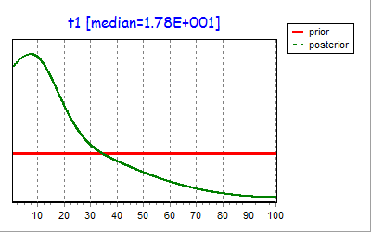
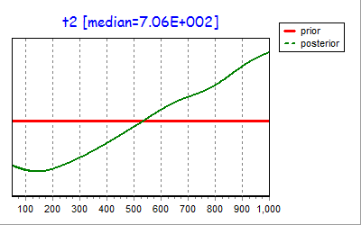
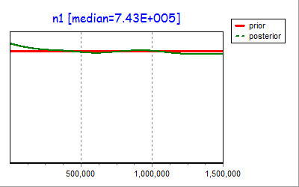
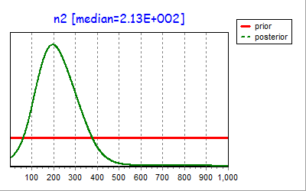
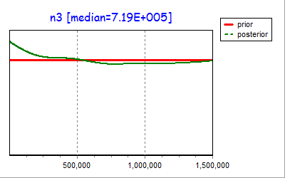
DS5_Harbor Seal Waddensee
Least Concern

Slide 6
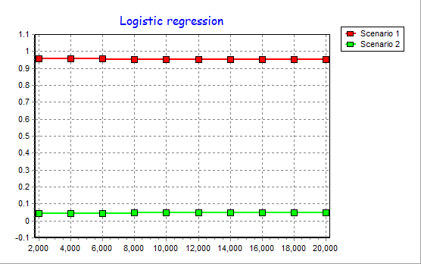
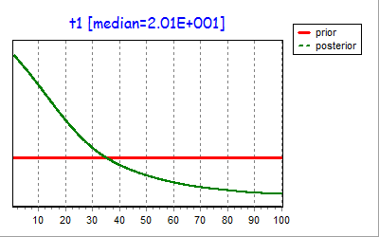
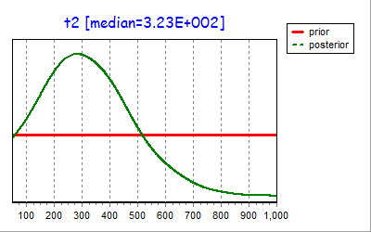
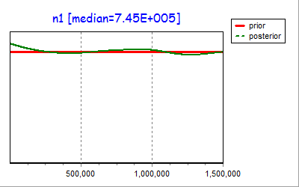
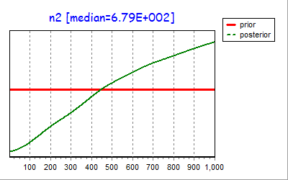
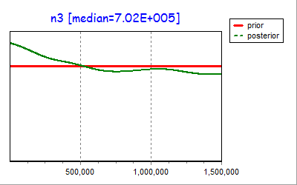
DS7_South American Fur Seal
Least Concern

Slide 7
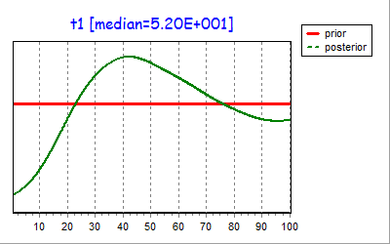
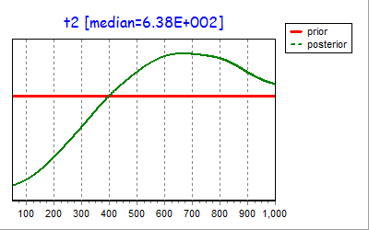
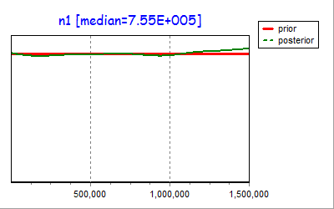
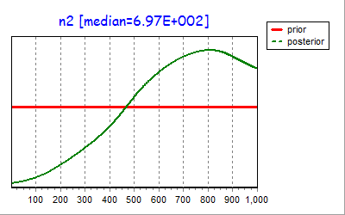
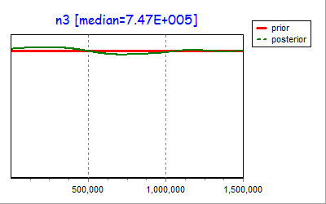
DS8_Hooded Seal
Decreasing

Slide 8
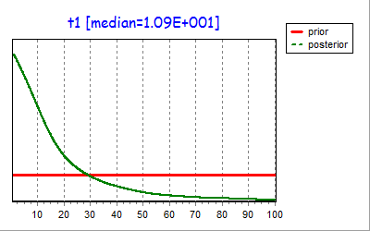
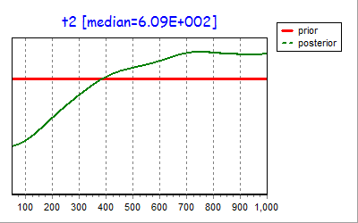
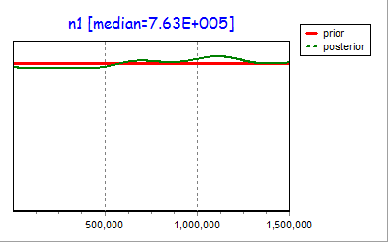
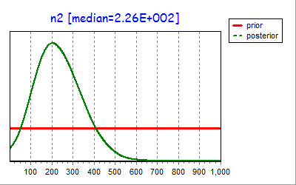
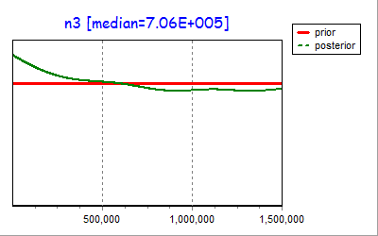
DS9_Mediterranean Monk Seal
Critically Endangered

Slide 9

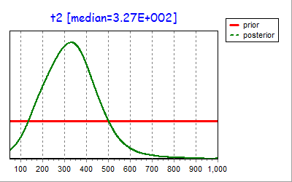
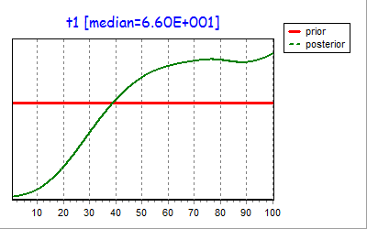
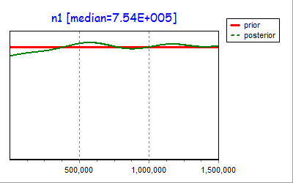
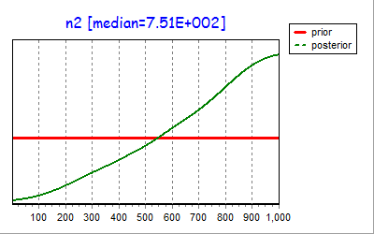
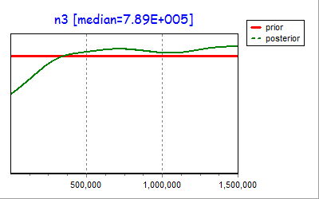
DS12_Crabeater Seal
Least Concern

Slide 10

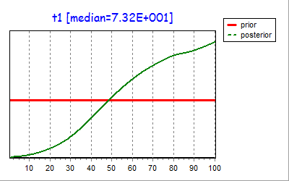
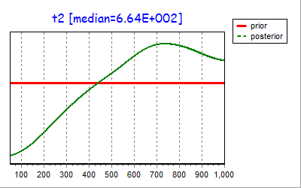
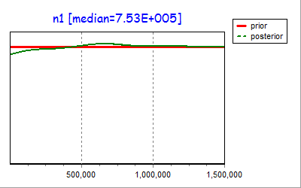
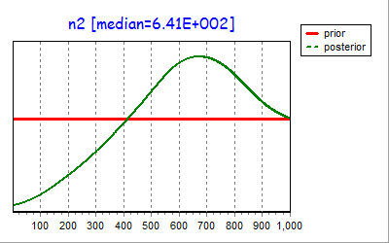
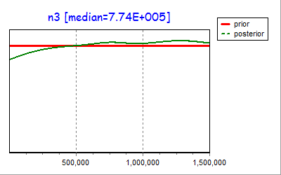
DS13_Leopard Seal
Least Concern

Slide 11

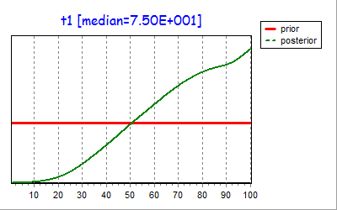
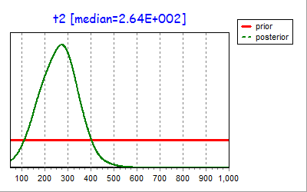


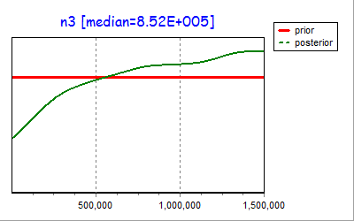
DS14_Ringed Seal
Least Concern

Slide 12

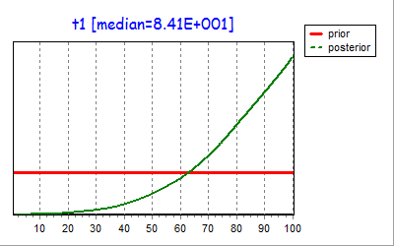
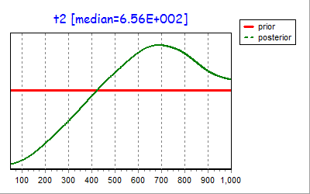
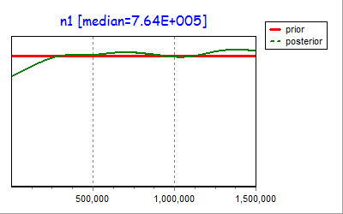
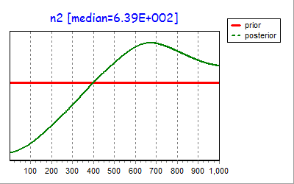

DS15_Ross Seal
Least Concern

Slide 13





DS17_Northern Fur Seal
Vulnerable

Slide 14






DS20_Northern Elephant Seal
Least Concern

Slide 15






DS21_Southern Elephant Seal
Least Concern

Slide 16






DS22_California Sea Lion
Least Concern

Slide 17






DS18_Atlantic Walrus Schafer
Unknown

Slide 18





DS19_Atlantic Walrus Andersen
Unknown

Slide 19






DS23_Steller Sea Lion Western
Endangered

Slide 20






DS24_Steller Sea Lion Eastern
Threatened

Slide 21






DS25_South American Fur Seal Brazilian
Least Concern

Slide 22
DS1_Antarctic Fur Seal
DS3_Steller Sea Lion
DS5_Harbor Seal Waddensee

